Slide 1


2023
SAM SYSTEM
Student Assessment Management System
RPS Green Savers

Slide 2

Agenda
1 | Meet the Team
2 | About the SAM System
3 | Functional Design
4 | Architecture & Design
5 | Cost
SAM SYSTEM

Slide 3







Meet the team
Gautam Narkar
Project Manager
RPS Green Savers
Suhas Harde
Lead
Sandeep Kumar
Yogesh Shukla
Shivani Mankar
Kruti Assar
Sandeep Sambre
SAM SYSTEM

Slide 4




Secured
Robust Design
SAM SYSTEM
Cost Effective
User Friendly

Slide 5
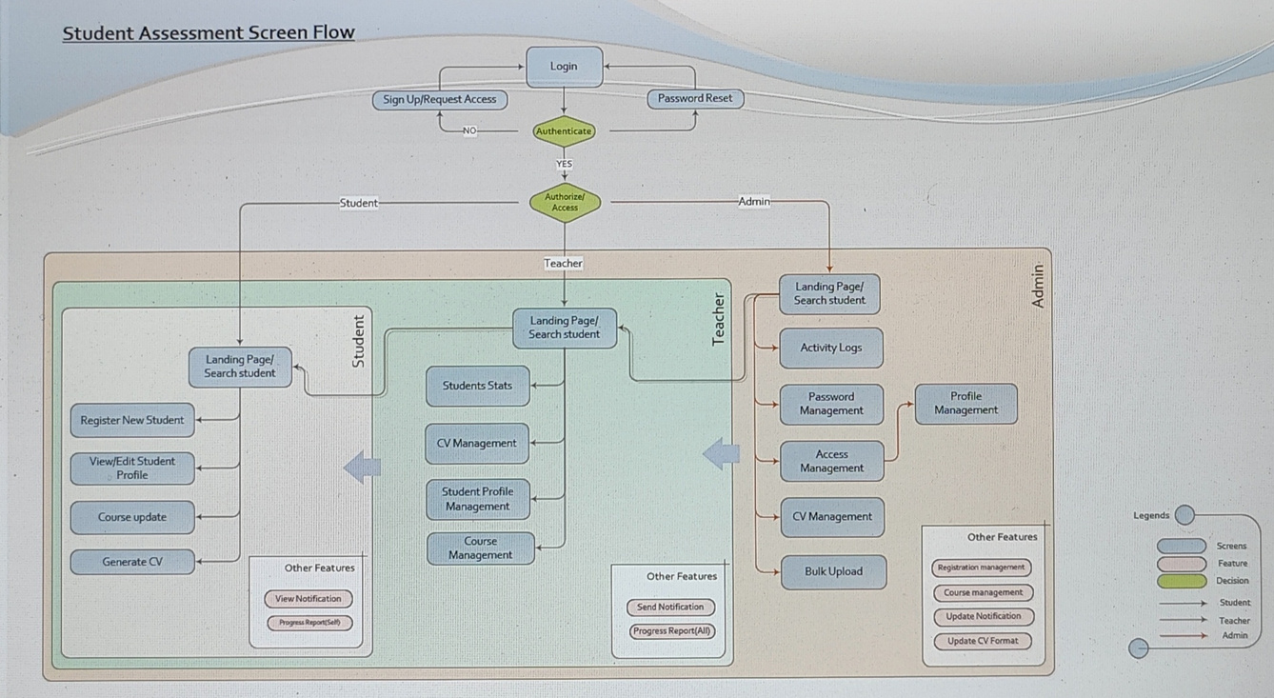

Functional Design
Requirement
Allow for the Organization to create Student profiles (register skills and other student history) on the application
Allow for the key stakeholder/teachers/admins to publish students track record - which could be assessment updates, Training completed, placement opportunities taken and review on dashboard.
Batch upload features for capturing all the data-for historical record keeping purposes.
Manage students' skills sets and prepare appropriate performance reports from the platform
Courses are classified into - Basic & Advanced for all the students
Student Demographics i.e. Pll Data needs to be stored
Generate CV in pdf format to be shared for placements
While designing admin template, accessibility features should be enabled
SAM SYSTEM

Slide 6
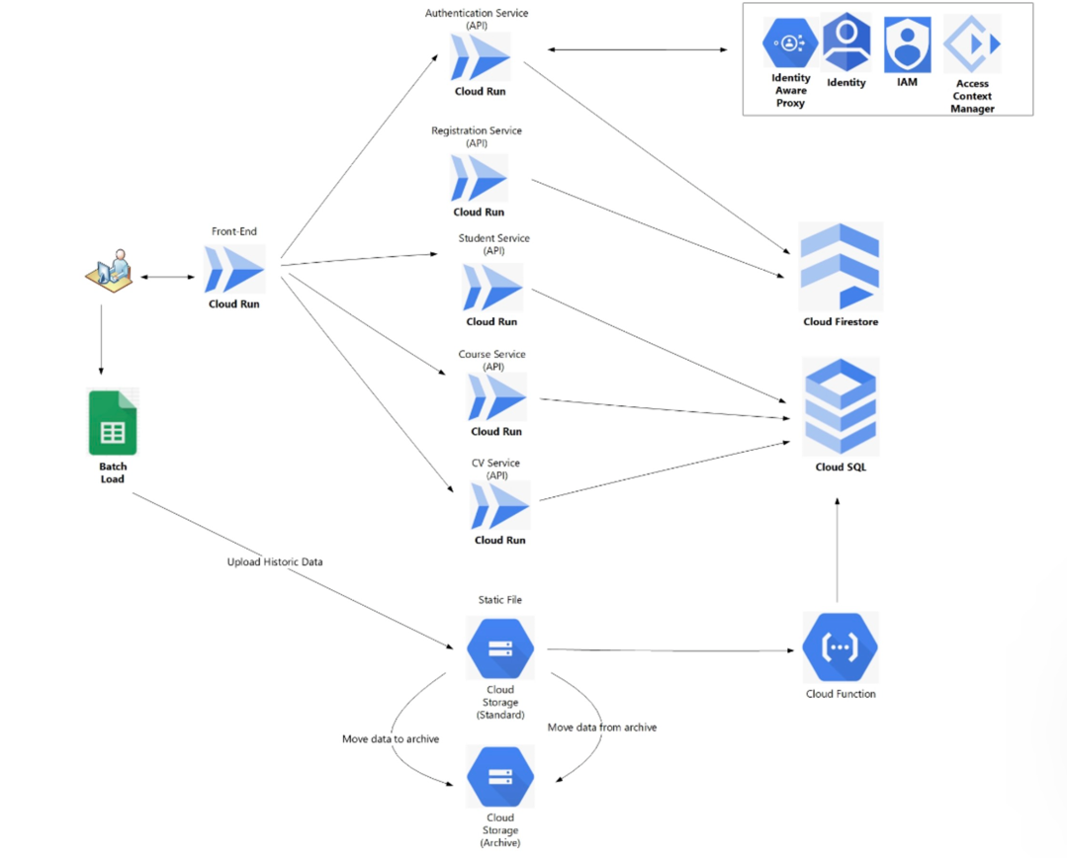

Architecture Design
Google Cloud Platform
Cloud Run
Cloud Storage
Cloud Firestore
Cloud Functions
Cloud SQL
Cloud IAM
SAM SYSTEM

Slide 7
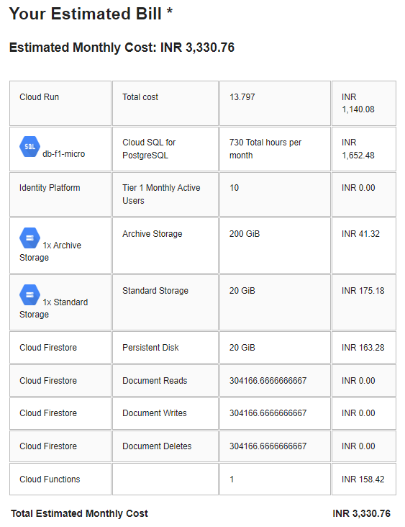

COST
Monthly Expenses
SAM SYSTEM

Slide 8


SAM SYSTEM
Team:
RPS Green Savers

